Slide 1
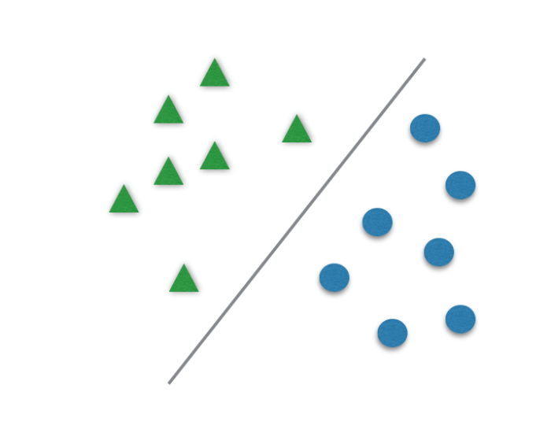
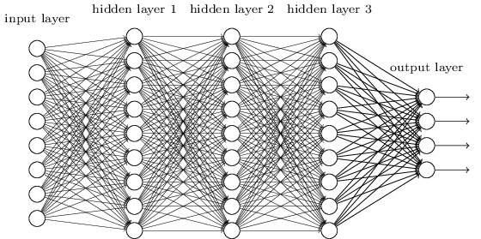
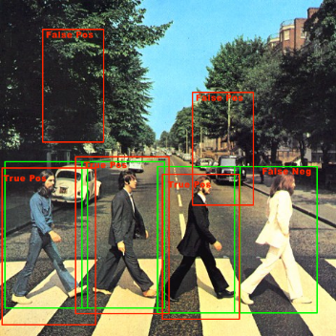
Learning, Representation, Vision.
Class 6: ML experimental practice and task guidance
Aharon Bar Hillel 19/11/2018

Slide 2
Programming task 1
Implement an object recognition pipe
In Python, using publically available libraries for pipe components
Optional pipes: HOG+SVM, SIFT+Kmeans + SVM, NBNN
Train it on a subset of the Caletch101 dataset
Train and tune your hyper parameters on 10 classes
Test your performance on another subset
Test the tuned pipe on 10 different classes. The code should support running on any arbitrary subset of 10 classes
Report your results
Graphs of hyper parameter tuning
Test error and confusion matrix
Showing the erroneous images
Who and when?
In groups of up to 2 people
Task detailed description is in the Moodle.
Submission of code and report is till Saturday 28/12 at midnight.

Slide 3
A generic Machine Learning (ML) experiment pipe
The main function is something like:
Params= GetDefaultParameters()
…. (experiment specific parameters override)
Np.random.seed(0); % Seed the random number generator
DandL= GetData(Params[‘Data’])
SplitData= TrainTestSplit( DandL[‘Data’], DandL[‘Labels’], Params[‘Split’])
# returns train data, test data, train labels and test labels
TrainDataRep = Prepare( SplitData[‘Train’][‘Data’], Params[‘Prepare’])
Model = Train(TrainDataRep, SplitData[‘Train’][‘Labels’] , Params[‘Train’])
TestDataRep = Prepare(SplitData[‘Test’][‘Data’], Params[‘Preapare’])
Results = Test(Model, TestDataRep)
Summary = Evaluate(Results, SplitData[‘Test’][‘Labels’], Params[‘Summary’])
ReportResults(Summary, Params[‘Report’])

Slide 4
Functions at the generic pipe (1)
Minimal code duplications
For different experiments, only the main function should change
Each experiment has a different main function (called Exp_1, Exp_2)
Experiments differ from each other mostly by overriding parameters
The rest of the code should be fixed
No code duplication between experiments (except of the main function)
Params = GetDefaultParameters()
Returns a dict containing the default experiment parameters
It has several fields, each itself a dict of parameters for the various experiment stages
These are ‘Split’, ‘Prepare’, ‘Train’, ‘Summary’, ‘Report’ (according to the needs)
Each struct is sent to the relevant function (i.e. Params[‘Train’] is sent to Train(), etc.)
Each experiment starts by configuring the experiment parameters:
Calling GetDefaultParameters()
Changing relevant parameters according to the specific experiments needs
Do not keep hidden constants in the code (use parameters to set them)

Slide 5
Functions at the generic pipe (2)
DandL= GetData(Params[‘Data’])
Loads the data and subsets it if required
Puts the data in DandL[‘Data’], the labels in DandL[‘Labels’]
In our case: Params include a path for the data and sub-setting parameters
SplitData= TrainTestSplit( DandL[‘Data’], DandL[‘Labels’], Params[‘Split’])
Splits the data and labels according to a ratio defined in Params
SplitData includes fields: TrainData, TestData, TrainLabels, TestLabels
DataRep = Prepare(Data, Params)
Compute the representation function: Turn the images into vectors for classification
Train(), Test() – the functions implementing the actual learning algorithm and the classifier
If hyper parameter tuning is required, replace the call to train() in main with a call to TrainWithTuning() which internally also does the hyper parameter tuning (see slides 11-14)

Slide 6
Functions at the generic pipe (3)
Summary = Evaluate(Results, SplitData[‘Test’][‘Labels’], Params[‘Summary’])
Compute the results statistics and return them as fields of Summary
For classification these are:
Most important: the error rate
In our case also: Confusion matrix, the indices of the largest error images
ReportResults( Summary, Params)
Draws the results figures, reports results to the screen
Saves the results to the results path, to a file named according to the experiment name or number
(e.g. to Results\ResultsOfExp_xx.pkl)

Slide 7
A generic ML experiment pipe - emphasizes
Data and algorithm independence
So switching data will be seamless
The same ‘prepare’ code is used for train and test , and prepare() is not aware if it processes train or test data
To avoid possible train:test discrepancies and code duplication.
Support caching for time-consuming operations repeating across experiments
FileName = [Params[‘Cache’][‘CachePath’] + Params[‘Cache’][‘CacheFileName’]
If Params[‘Cache’][‘UseCacheFlagForXX’]
Data=load(FileName )
else
Data= PreapreDataFromFolder(Params[‘Data’])
Save(FileName ,’Data’)
End

Slide 8
Function documentation format
The documentation should be Right below the function declaration
It should include:
One line describing the function in general
Input:
Input 1 – description
For a vector/ matrix: describe its size and the semantics of different dimensions
For a struct: describe its fields one-by-one
Or refer to its documentation elsewhere. No duplicate documentations
Input 2 – descriptions
…
Output (the fields in the tuple returned)
Output 1 – description
Output 2 – Description
…
(Optional) – more details description of the function and the contexts in which it is used
(Optional) – See also: < List of other relevant functions >

Slide 9
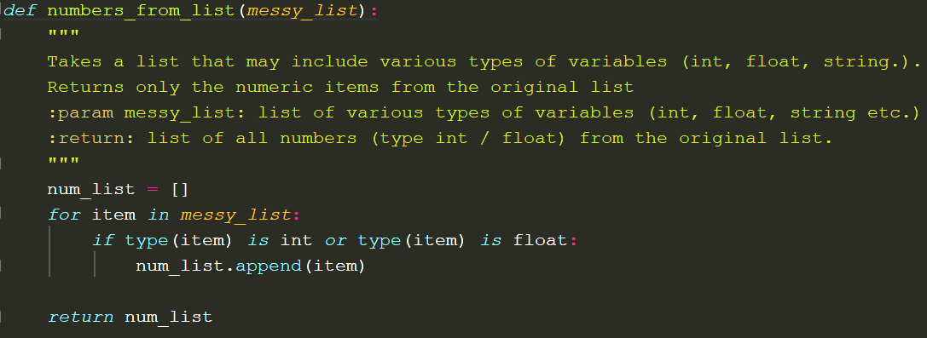
Function documentation format: Python Example (PEP8 styling convention)

Slide 10
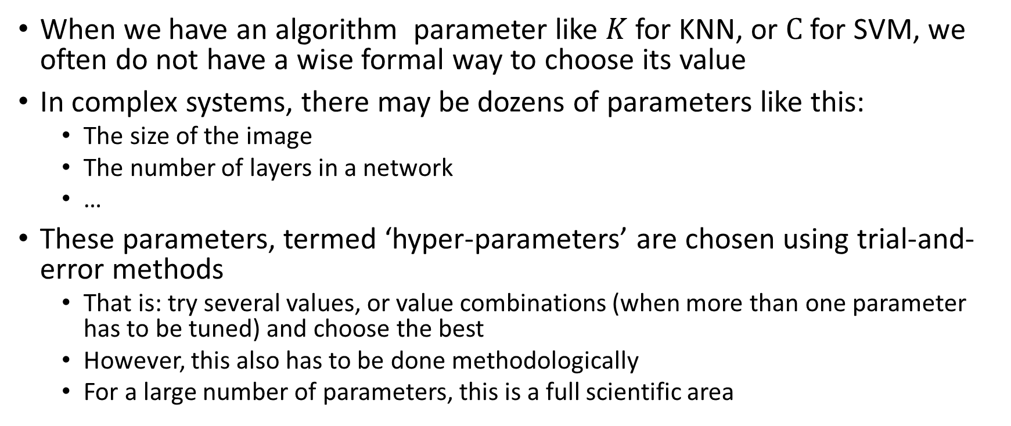
Choosing a hyper parameter
When we have an algorithm parameter like $K$ for KNN, or $C$ for SVM, we often do not have a wise formal way to choose its value
In complex systems, there may be dozens of parameters like this:
The size of the image
The number of layers in a network
…
These parameters, termed ‘hyper-parameters’ are chosen using trial-and-error methods
That is: try several values, or value combinations (when more than one parameter has to be tuned) and choose the best
However, this also has to be done methodologically
For a large number of parameters, this is a full scientific area

Slide 11
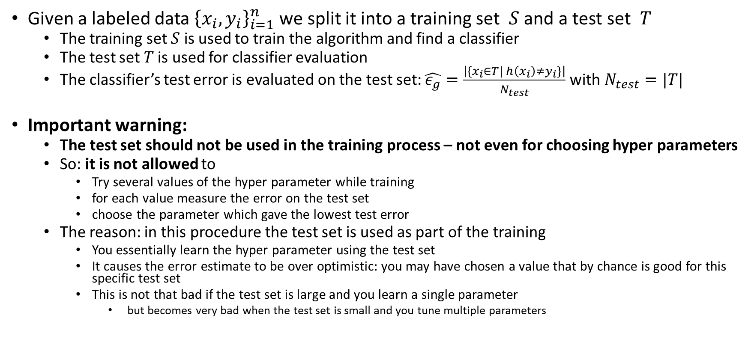
Hyper parameters are not chosen using the test set
Given a labeled data ${\left\{x_{i},y_{i}\right\}}_{i=1}^{n}$ we split it into a training set $S$ and a test set $T$
The training set $S$ is used to train the algorithm and find a classifier
The test set $T$ is used for classifier evaluation
The classifier’s test error is evaluated on the test set: $\hat{ε_{g}}=\frac{\left|\left\{x_{i}∈T| h\left(x_{i}\right)≠y_{i}\right\}\right|}{N_{test}}$ with $N_{test}=|T|$
Important warning:
The test set should not be used in the training process – not even for choosing hyper parameters
So: it is not allowed to
Try several values of the hyper parameter while training
for each value measure the error on the test set
choose the parameter which gave the lowest test error
The reason: in this procedure the test set is used as part of the training
You essentially learn the hyper parameter using the test set
It causes the error estimate to be over optimistic: you may have chosen a value that by chance is good for this specific test set
This is not that bad if the test set is large and you learn a single parameter
but becomes very bad when the test set is small and you tune multiple parameters

Slide 12
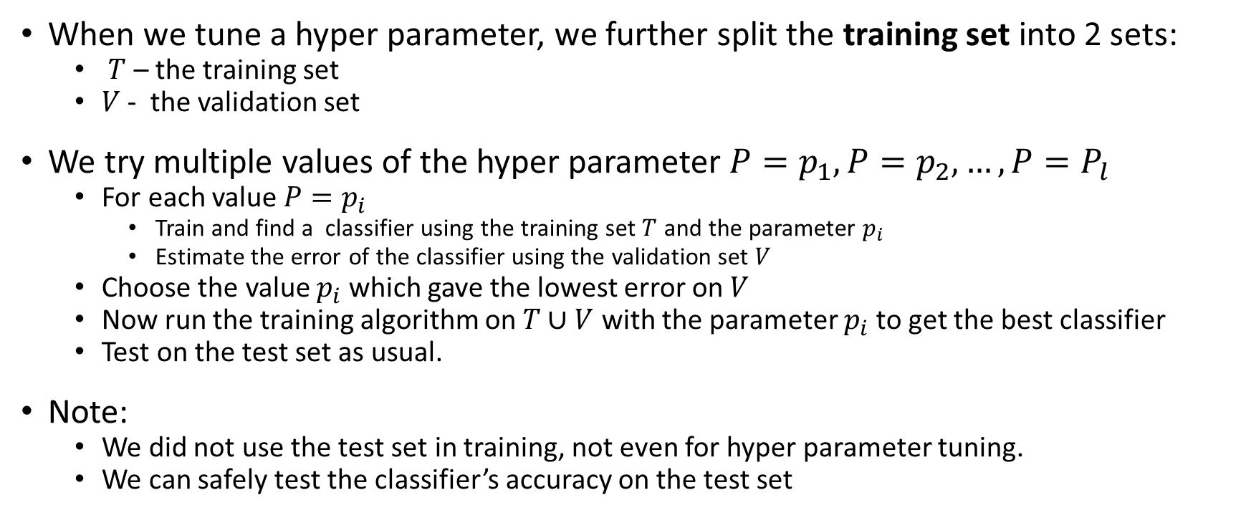
Choosing a hyper parameter - method 1: Use a validation set
When we tune a hyper parameter, we further split the training set into 2 sets:
$T$ – the training set
$V$ - the validation set
We try multiple values of the hyper parameter $P=p_{1},P=p_{2},…,P=P_{l}$
For each value $P=p_{i}$
Train and find a classifier using the training set $T$ and the parameter $p_{i}$
Estimate the error of the classifier using the validation set $V$
Choose the value $p_{i}$ which gave the lowest error on $V$
Now run the training algorithm on $T∪V$ with the parameter $p_{i}$ to get the best classifier
Test on the test set as usual.
Note:
We did not use the test set in training, not even for hyper parameter tuning.
We can safely test the classifier’s accuracy on the test set

Slide 13
Choosing a hyper parameter - method 2: K-fold cross validation
This is a more reliable, but more expensive (computationally) method for hyper parameter tuning
Instead of cutting the training set once into $T$ and $V$, we do it K times
The procedure:
Split the training set $T$ into $K$ folds, i.e. disjoint subsets of equal size. T=$T_{1}∪T_{2}∪…,∪T_{k}$
For each optional value $P=p_{1},…,P=P_{l}$
For $k=1,..,K$
Train and find classifier using $P=p_{i}$ , with all the folds except of fold $k$ as the training set
Estimate the error $\hat{ε_{g}}(p_{i},k)$ of the classifier using fold $k$
End
Compute the average error of parameter $p_{i}:$ $\hat{ε_{g}}\left(p_{i}\right)=\frac{1}{k}\sum_{k}{\hat{ε_{g}}(p_{i},k)}$
End
Choose the best parameter value index $best=argmin_{i}\hat{ε_{g}}\left(p_{i}\right)$
Now train on all the train data $T$ using the best parameter found $P_{best}$
Finally, test your classifier on the test set as always

